Slide 1

Do Discounts Deliver?
Garrett Estey
Hyoeun Kim
Kateryna Kovalova
Team of students of WBS coding school

Slide 2
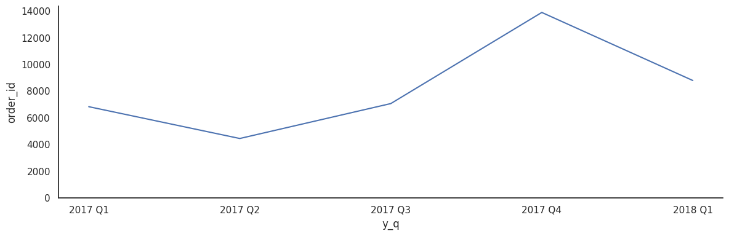
Order placed by Quarter
+96% growth in 2017 Q4

Slide 3
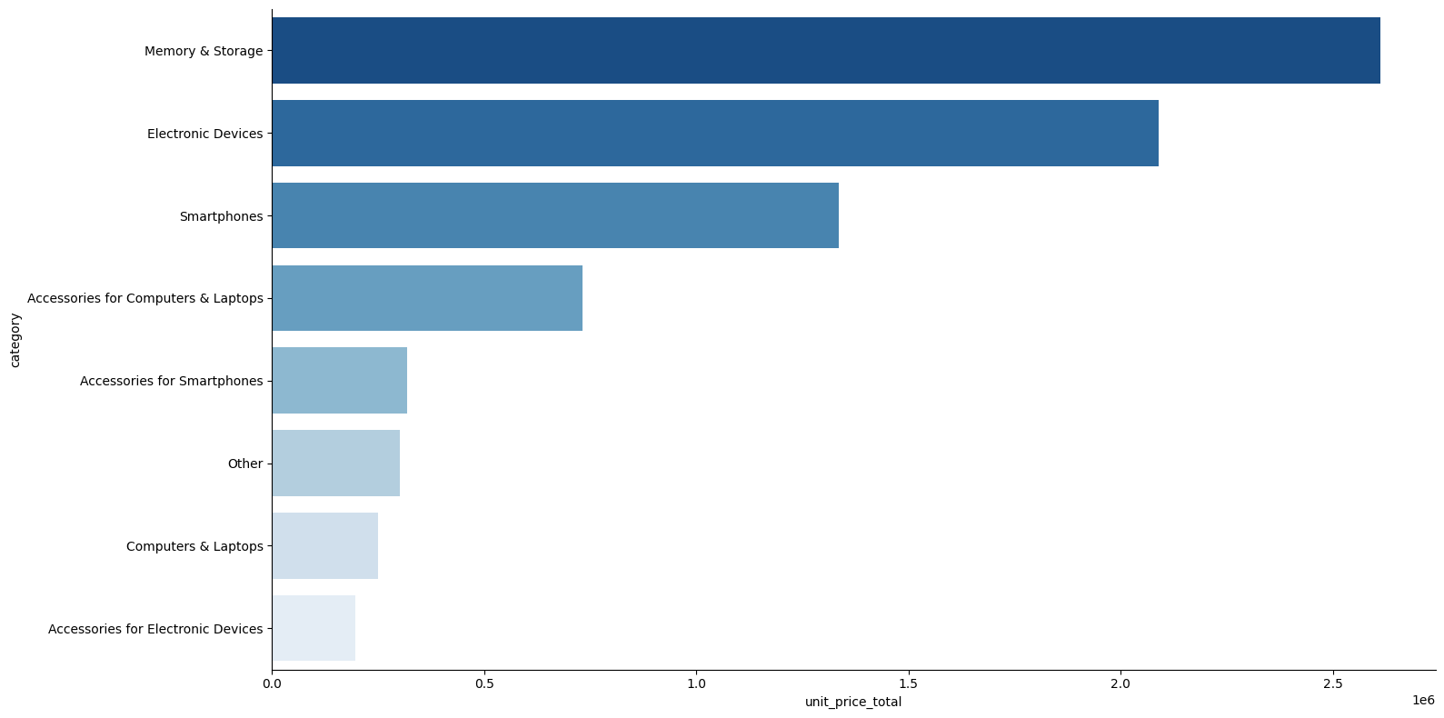
Revenue per Category

Slide 4
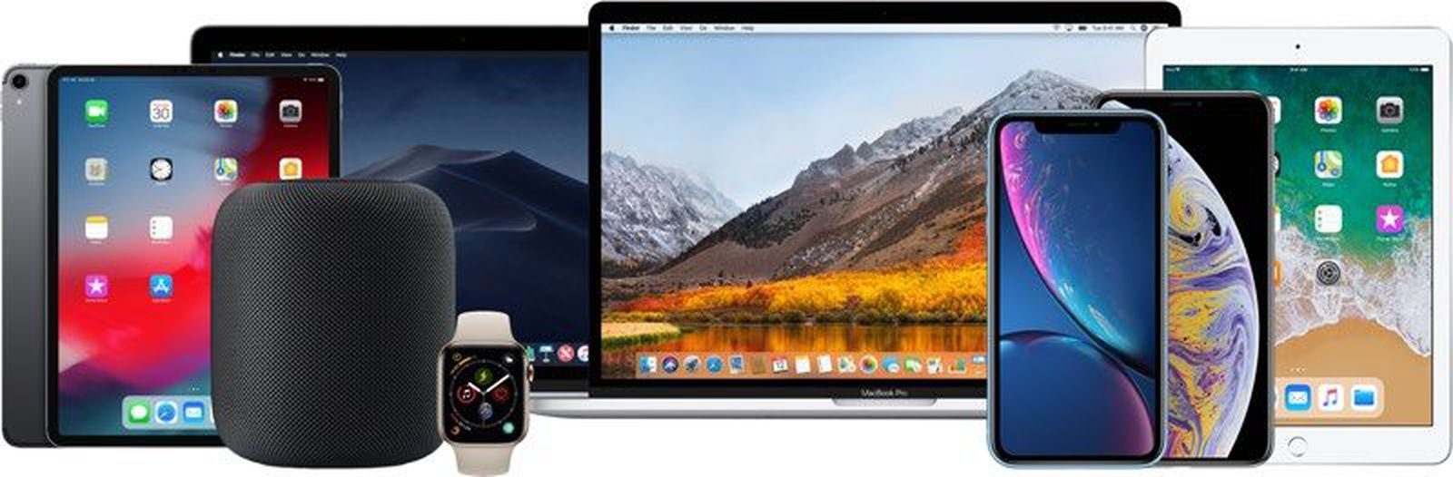
2017 Apple Releases
Ipad Pro Apple IMAC Apple Watch 3
Macbook Pro Apple TV 4K Iphone X
Macbook Air Iphone 8 HomePod

Slide 5
of products are discounted
49%

Slide 6
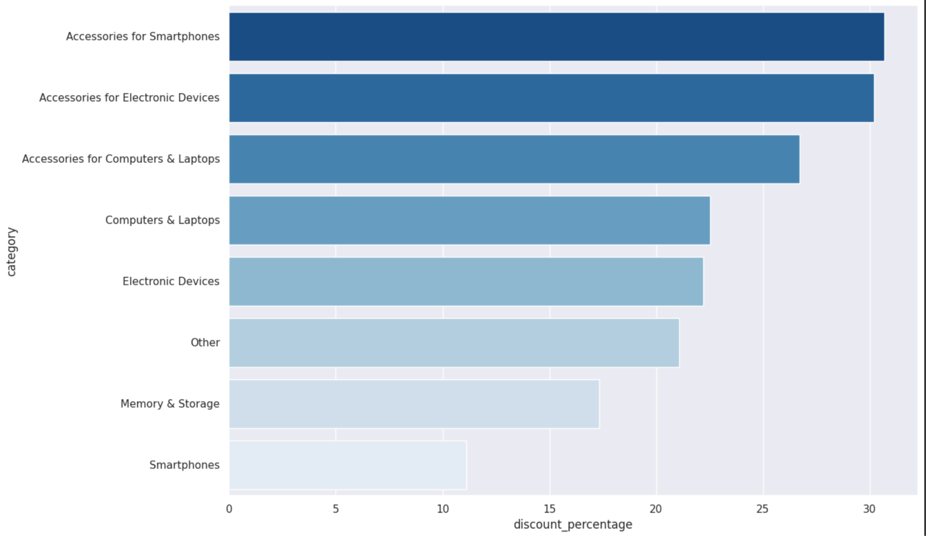
Discounts for different categories

Slide 7
In 13 months,
the company’s revenue amounted to
more than 11 million

Slide 8
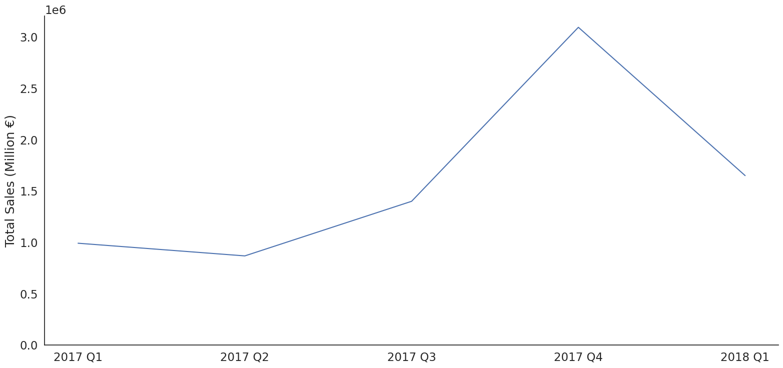
Sales by Quarter
+121% growth in 2017 Q4

Slide 9
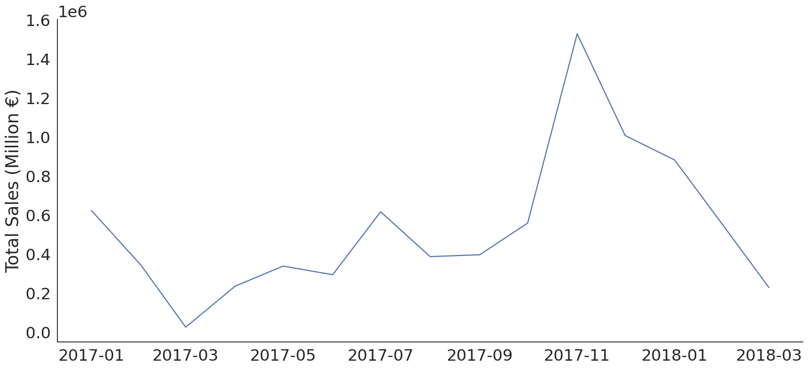
Sales by month
Jan 2018 YOY growth
+41.5%

Slide 10
Conclusion
My team and I believe that the marketing and discounts offered are beneficial in the short term.
Growth in Orders Placed
Growth in Total Revenue
Growth in New Customers
Notes:
ADD MORE DETAIL HERE, FOR WHY

Slide 11
Questions?
Team of students of WBS coding school

